Slide 1
Relational DB Constraints & SQL
Session 03
Rico Halim, S.Kom., M.Kom.

Slide 2
Learning Outcomes
Session 3
At the end of this session, students will be able to:
LO-1 : Define model data and information in the form of conceptual and apply them to the DBMS, both individually and in teamwork.

Slide 3
outline
Session 3
Integrity Constraints
Keys in Relational Database
Foreign Key & Referential Integrity
SQL Data Manipulation

Slide 4
INTEGRITY CONSTRAINTS
Why Constraints Matter?
A database without constraints is like a bank without rules — anyone can withdraw unlimited money, and transfers can go to non-existent accounts.
Constraints are rules enforced by the DBMS to ensure:
Accuracy — only valid data can be stored
Consistency — data across tables stays in sync
Reliability — prevents accidental corruption from bad INSERT, UPDATE, or DELETE
The DBMS rejects any operation that violates a constraint — before the data is saved

Slide 5
INTEGRITY CONSTRAINTS
What Could Go Wrong?
Without constraints, these could happen:
A student enrolls in a course that doesn't exist
An order references a customer_id that was never created
Two employees share the same employee_id
A product price is set to negative value
A required field like email is left empty
These are not hypothetical — they happen in real systems without proper constraints.

Slide 6
INTEGRITY CONSTRAINTS
Types of Constraints
Constraint | What It Does | Example
NOT NULL | Column cannot be empty | name cannot be NULL
UNIQUE | No duplicate values allowed | email must be unique
PRIMARY KEY | Uniquely identifies each row (NOT NULL + UNIQUE) | student_id
FOREIGN KEY | References a row in another table | order.customer_id → customer.customer_id
CHECK | Value must satisfy a condition | price > 0
DEFAULT | Auto-fills a value if none is given | status = 'active'
Every constraint has one job: prevent bad data from entering the database

Slide 7
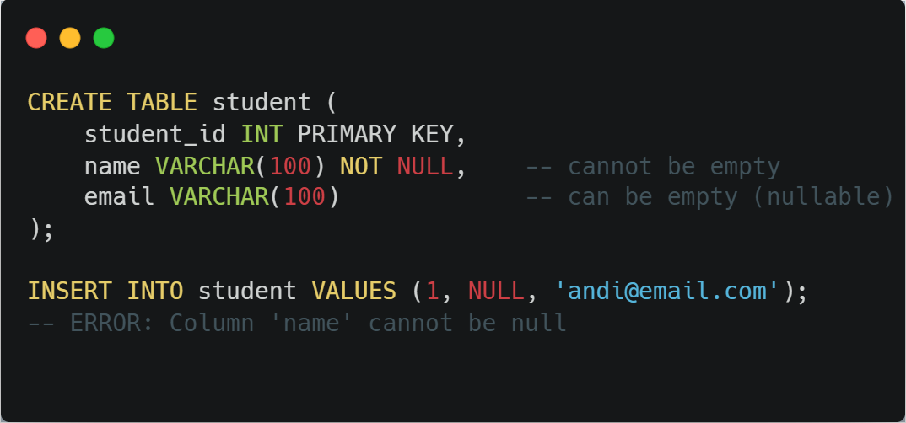
INTEGRITY CONSTRAINTS
NOT NULL & UNIQUE
NOT NULL — the column must always have a value.
Key difference: NOT NULL = "must have a value", UNIQUE = "must be different from others". PRIMARY KEY = both combined

Slide 8
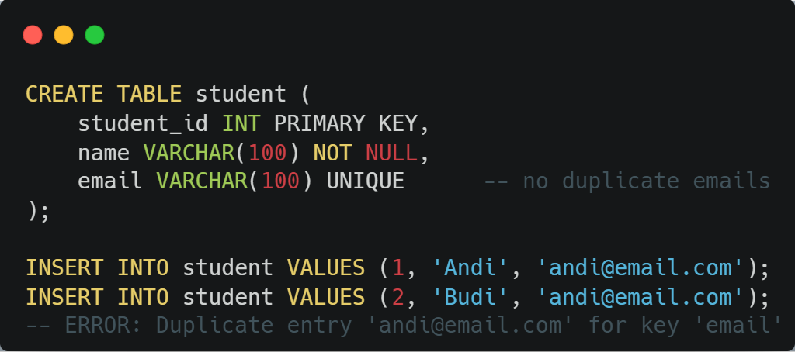
INTEGRITY CONSTRAINTS
NOT NULL & UNIQUE
UNIQUE — no two rows can have the same value in this column.
Key difference: NOT NULL = "must have a value", UNIQUE = "must be different from others". PRIMARY KEY = both combined

Slide 9
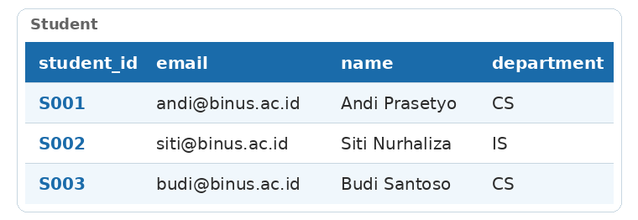
KEYS IN RELATIONAL DATABASE
Super Key, Candidate Key & Primary Key
Consider this Student table:

Slide 10
KEYS IN RELATIONAL DATABASE
Super Key, Candidate Key & Primary Key
Super Key — any set of columns that can uniquely identify a row.
{student_id}, {email}, {student_id, name}, {student_id, email, name, department}
Candidate Key — a minimal super key (remove any column and it loses uniqueness).
{student_id}, {email}
Primary Key — the ONE candidate key chosen to officially identify each row.
We choose: student_id
Think of it as: Super Key → filter out non-minimal → Candidate Keys → pick one → Primary Key.

Slide 11
KEYS IN RELATIONAL DATABASE
Choosing a Primary Key
Natural Key — uses existing real-world data.
Example: email, national_id, ISBN
Pros: meaningful, no extra column needed
Cons: can change (email), may be long (ISBN), privacy concern (national_id)
Surrogate Key — system-generated, has no business meaning.
Example: AUTO_INCREMENT id, UUID
Pros: never changes, short, guaranteed unique
Cons: meaningless to humans, extra column

Slide 12
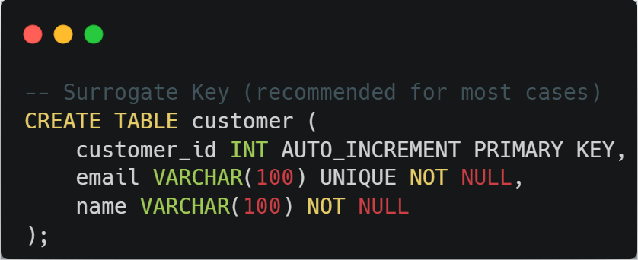
KEYS IN RELATIONAL DATABASE
Choosing a Primary Key
Best practice: Use surrogate key as PRIMARY KEY, and add UNIQUE constraint on natural key (like email) for business-level uniqueness

Slide 13

KEYS IN RELATIONAL DATABASE
Composite Key
A composite key uses two or more columns together to uniquely identify a row. Neither column is unique on its own.
Example: A student can enroll in many courses, and a course can have many students.

Slide 14
KEYS IN RELATIONAL DATABASE
Composite Key
A composite key uses two or more columns together to uniquely identify a row. Neither column is unique on its own.
Example: A student can enroll in many courses, and a course can have many students.

Slide 15
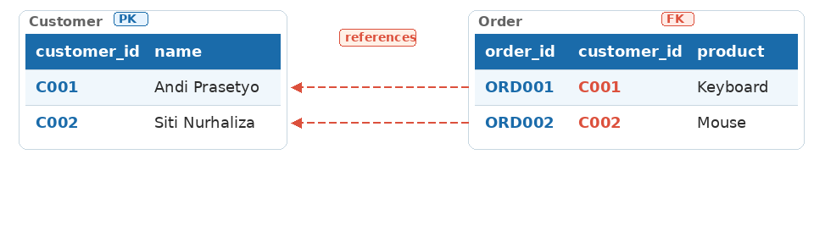
FOREIGN KEY & REFERENTIAL INTEGRITY
What is a Foreign Key?
A Foreign Key (FK) is a column in one table that references the Primary Key of another table. It acts as a "logical pointer" that connects two tables.
Parent table (referenced): Customer — has the Primary Key
Child table (referencing): Order — has the Foreign Key

Slide 16
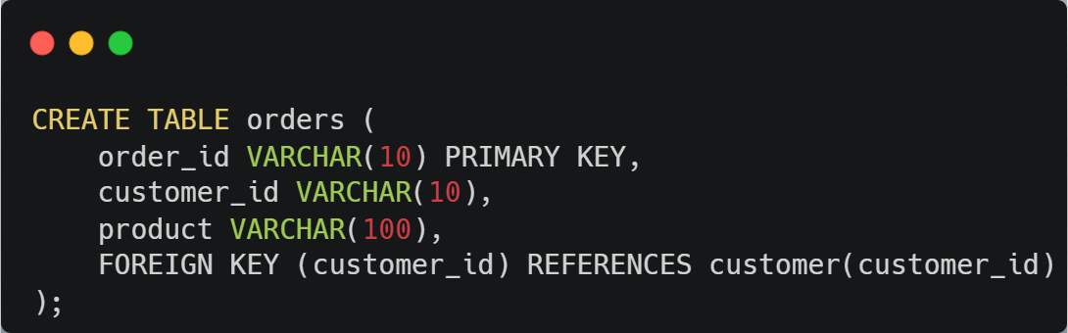
FOREIGN KEY & REFERENTIAL INTEGRITY
What is a Foreign Key?
The FK in Order must match an existing PK in Customer. You cannot create an order for a customer that doesn't exist.

Slide 17
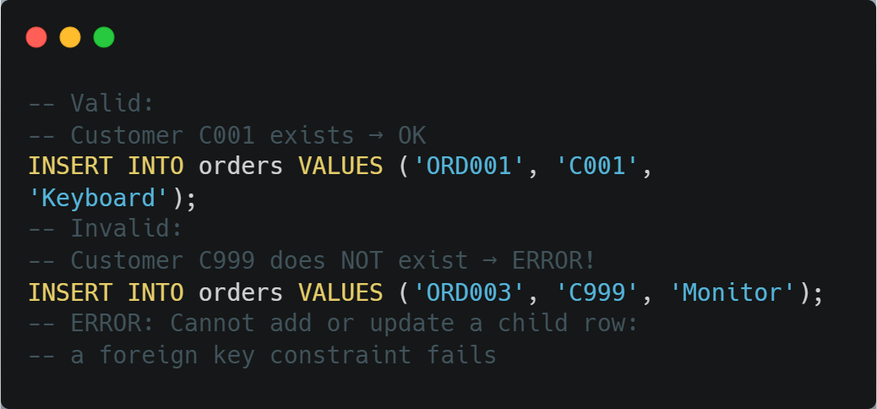
FOREIGN KEY & REFERENTIAL INTEGRITY
Referential Integrity
The referential integrity rule: every Foreign Key value must match an existing Primary Key value in the referenced table, or be NULL.

Slide 18
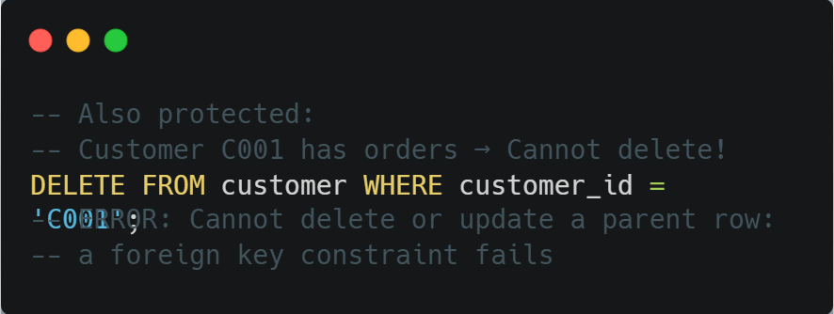
FOREIGN KEY & REFERENTIAL INTEGRITY
Referential Integrity
The referential integrity rule: every Foreign Key value must match an existing Primary Key value in the referenced table, or be NULL.
Two directions of protection:
Insert/Update child: FK value must exist in parent table
Delete/Update parent: cannot remove if child rows reference it

Slide 19
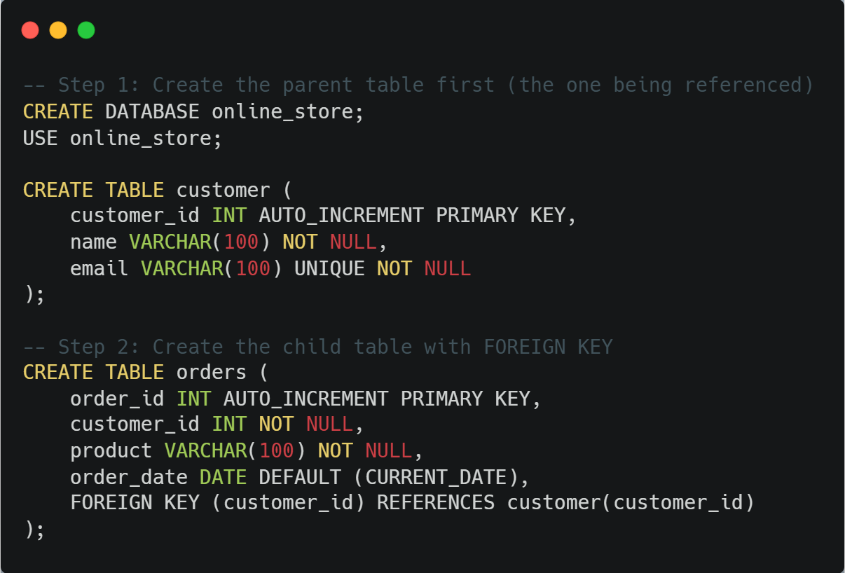
FOREIGN KEY & REFERENTIAL INTEGRITY
Live Coding: CREATE TABLE with PK & FK

Slide 20
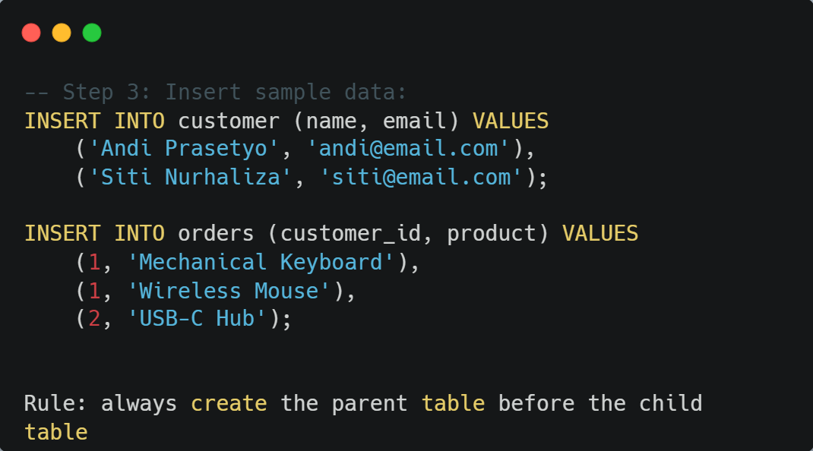
FOREIGN KEY & REFERENTIAL INTEGRITY
Live Coding: CREATE TABLE with PK & FK

Slide 21
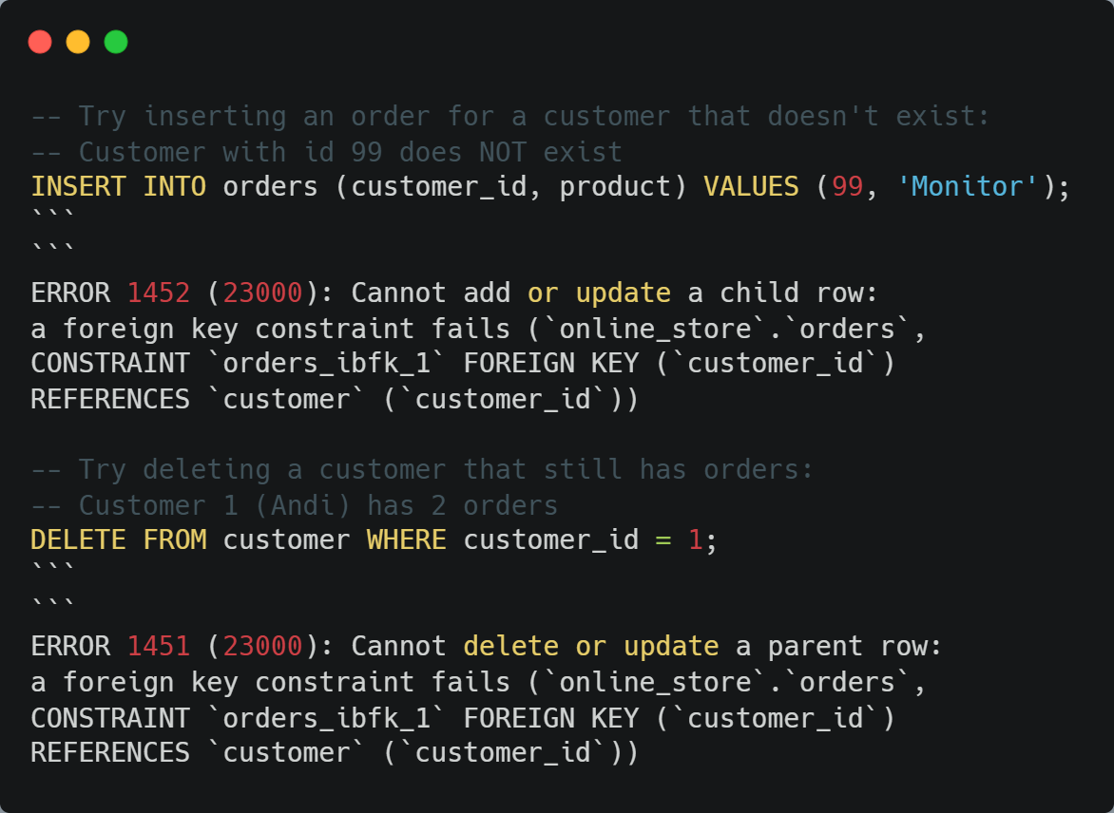
FOREIGN KEY & REFERENTIAL INTEGRITY
FK Violation Demo
The DBMS protects your data automatically. No bad data gets in, no referenced data gets accidentally deleted

Slide 22
FOREIGN KEY & REFERENTIAL INTEGRITY
Enforcing Constraints: ON DELETE / ON UPDATE
What should happen to child rows when the parent row is deleted or updated?
Option | On DELETE parent | On UPDATE parent PK | When to use
NO ACTION (default) | Block delete | Block update | Orders must keep their customer
CASCADE | Delete child rows too | Update FK automatically | Log entries tied to a session
SET NULL | Set FK to NULL | Set FK to NULL | Employee leaves, keep the project
SET DEFAULT | Set FK to default value | Set FK to default value | Rarely used in MySQL

Slide 23
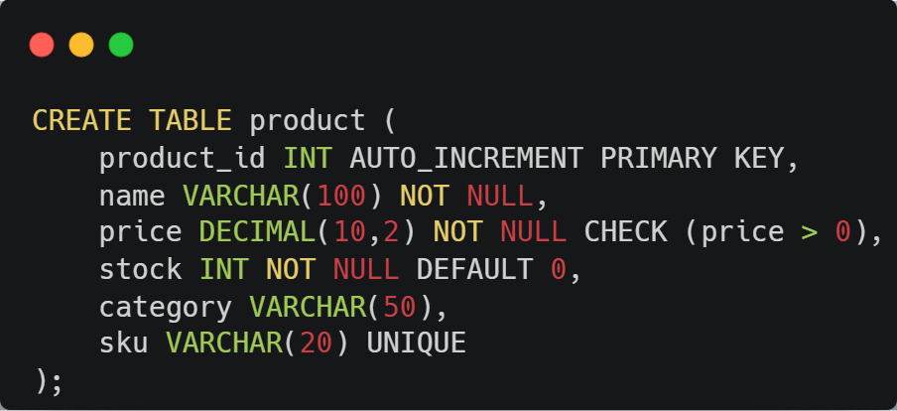
SQL DATA MANIPULATION
CREATE TABLE with Constraints
Putting all constraints together in one statement:
Constraint | Column | What it does
PRIMARY KEY | product_id | Unique identifier, auto-generated
NOT NULL | name, price, stock | Cannot be empty
CHECK | price | Must be greater than 0
DEFAULT | stock | Set to 0 if not provided
UNIQUE | sku | No duplicate SKU allowed

Slide 24
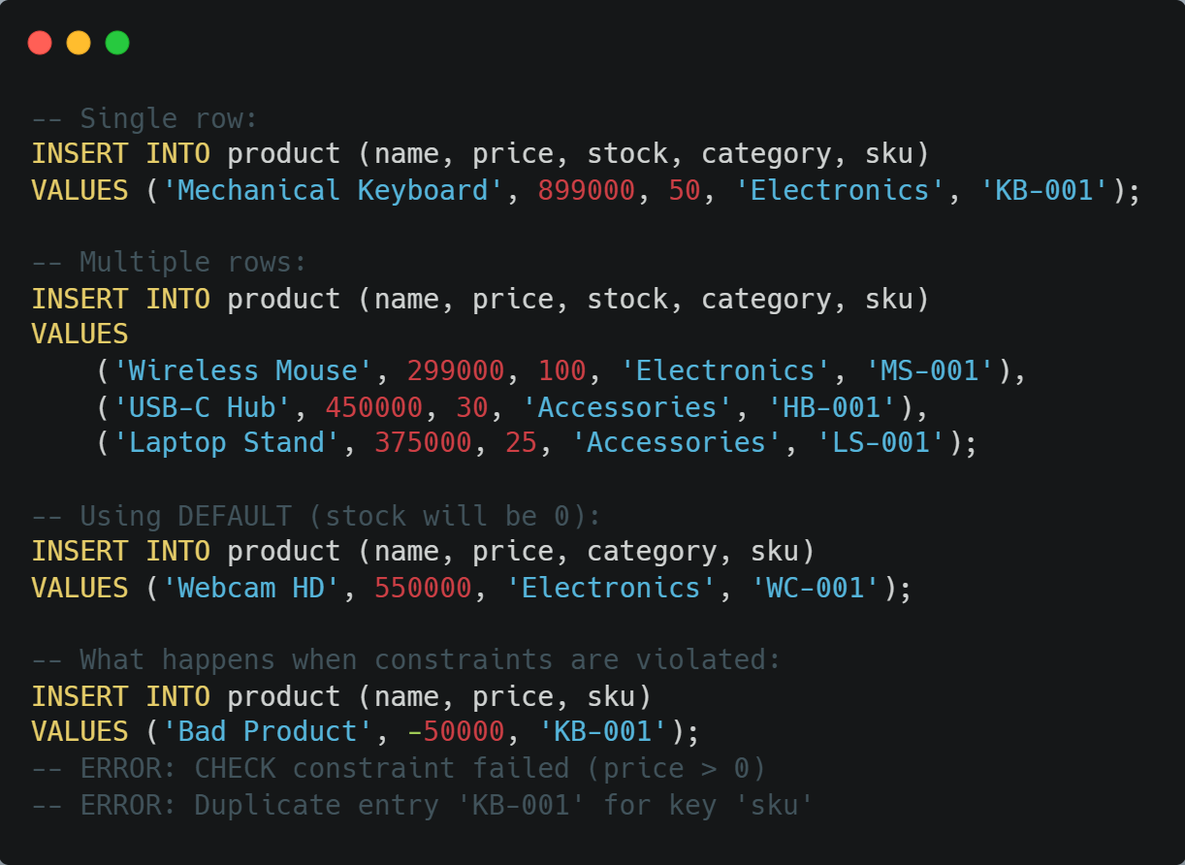
SQL DATA MANIPULATION
INSERT

Slide 25
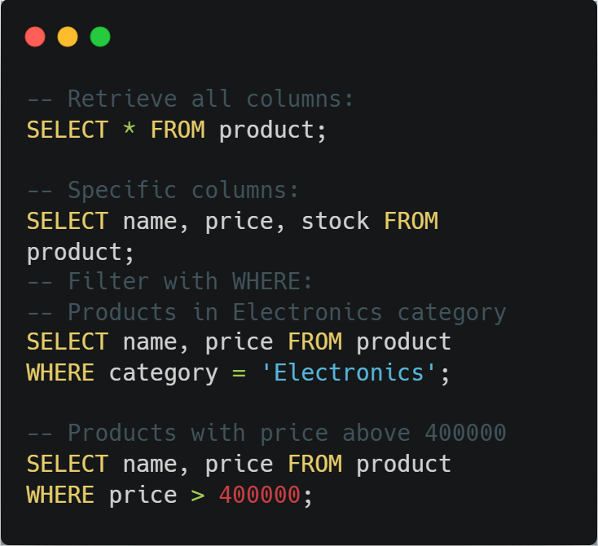
SQL DATA MANIPULATION
SELECT

Slide 26
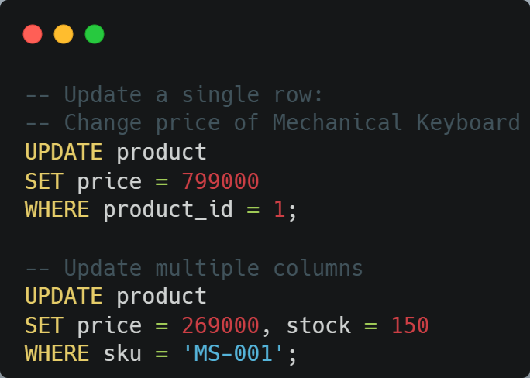
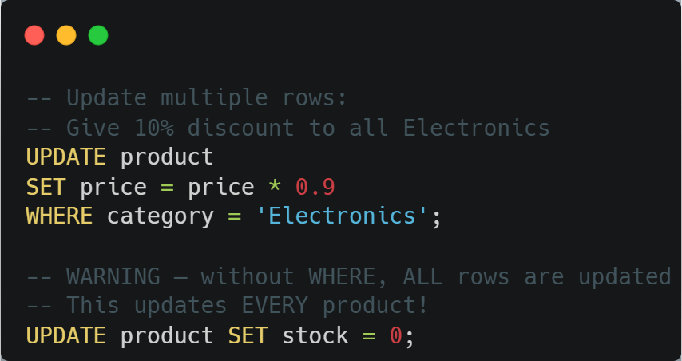
SQL DATA MANIPULATION
UPDATE
Always double-check your WHERE clause before running UPDATE.

Slide 27
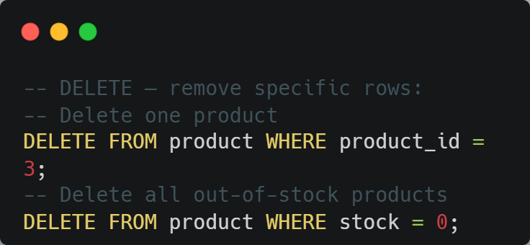
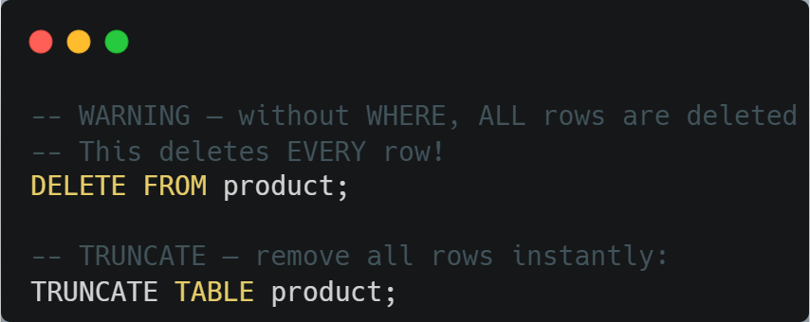
SQL DATA MANIPULATION
DELETE vs TRUNCATE
Best practice: Use DELETE with WHERE for specific rows. Use TRUNCATE only when you want a fresh start and no FK references exist.

Slide 28
SQL DATA MANIPULATION
DELETE vs TRUNCATE
 | DELETE | TRUNCATE
Filter rows | Yes (WHERE) | No (all rows)
Speed | Slower (row by row) | Faster (drops and recreates)
AUTO_INCREMENT | Keeps counter | Resets to 1
Rollback | Can rollback | Cannot rollback
FK constraint | Checked | Blocked if FK exists
Best practice: Use DELETE with WHERE for specific rows. Use TRUNCATE only when you want a fresh start and no FK references exist.

Slide 29
Summary
Integrity Constraints — Constraints are rules enforced by the DBMS to keep data accurate, consistent, and reliable. Types include NOT NULL, UNIQUE, CHECK, DEFAULT, PRIMARY KEY, and FOREIGN KEY.
Keys in Relational Database — Super Key → Candidate Key → Primary Key. Use surrogate keys for most cases. Composite keys are used when no single column is unique (e.g., junction tables).
Foreign Key & Referential Integrity — A Foreign Key references a Primary Key in another table. The DBMS blocks invalid inserts and protects parent rows from accidental deletion. Use ON DELETE/ON UPDATE to control behavior (NO ACTION, CASCADE, SET NULL).
SQL Data Manipulation — CREATE TABLE defines structure with constraints. INSERT adds data, SELECT retrieves, UPDATE modifies, DELETE removes. Always use WHERE with UPDATE and DELETE.

Slide 30
exercise
Scenario: FitZone is a gym that needs a database to manage members and their membership plans.
Requirements:
Each member has an id, name, email (unique), and phone number
The gym offers several membership plans (monthly, yearly, etc.) with a plan name and price
Each member subscribes to one plan, but a plan can have many members

Slide 31
exercise
Question 1: Write the CREATE TABLE statements for both tables. Include appropriate constraints: PRIMARY KEY, NOT NULL, UNIQUE, CHECK (price > 0), and FOREIGN KEY.
Question 2: Choose the ON DELETE and ON UPDATE behavior for the Foreign Key. Justify your choice: what should happen to member records if a plan is deleted or its id is updated?
Question 3: Insert at least 3 membership plans and 5 members. Then write:
  A SELECT query to show all members and their plan names
  An UPDATE to change a member's plan
  A DELETE to remove a member who cancelled

Slide 32
References
Session 3
Murach, J. (2023). Murach's MySQL, 4th Edition. Mike Murach & Associates. Chapter 1, 5, 11.
Elmasri, R. & Navathe, S. (2015). Fundamentals of Database Systems, 7th Edition. Pearson. Chapter 5.

